Slide 1
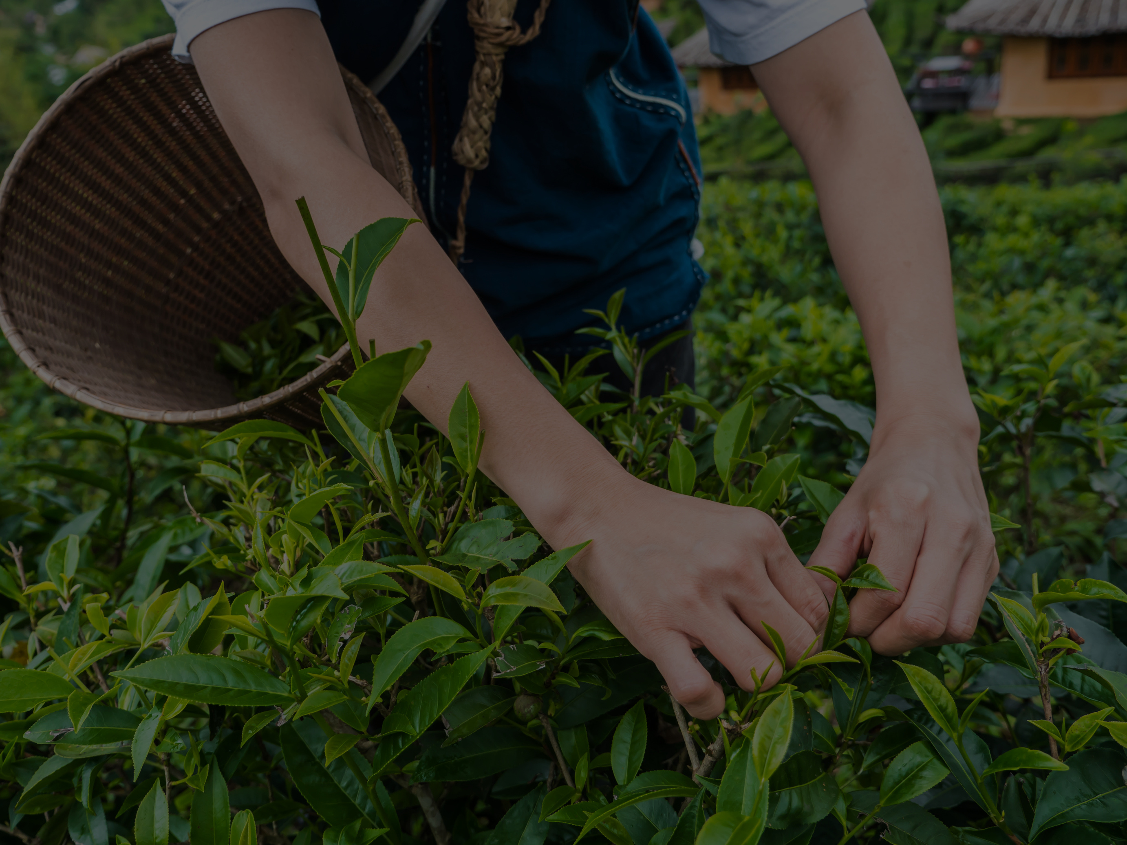




01
AgriLens
Project Profile
Cultivating the Future of Agriculture
Supervised by:
Assoc.Prof. Samir El-Mougy
Eng. Mai Mohamed
Presented by
Date
AgriLens Teem
12July 2025

Slide 2



02
AGENDA
01
Introduction
02
Problem Statement & Challenges
03
Project Objectives
04
Related Work & Relationship
05
Swot Analysis
& Business Model
06
System Architecture & System Analysis
07
Proposed Solution
08
AI
09
Demo
10
Technology & Future Work
11
Conclusion
LEARN MORE
www.agrilens.com

Slide 3

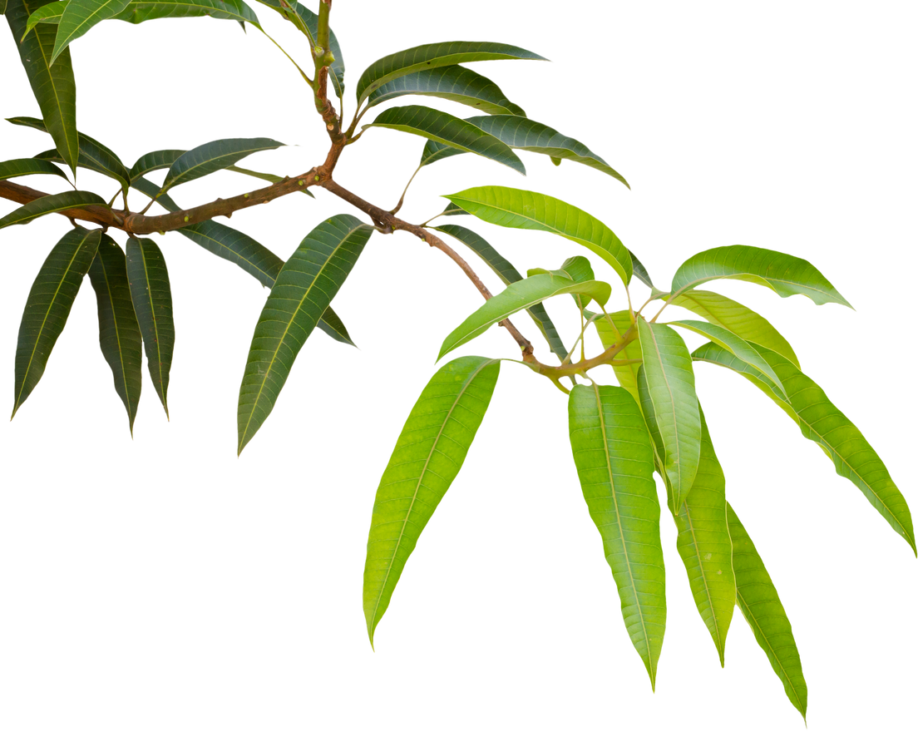

03
INTRODUCTION
AgriLens harnesses artificial intelligence and the Internet of Things to revolutionize the agricultural sector in Egypt, offering real-time insights, automation, and predictive capabilities that were previously unavailable. We specifically target a diverse group of stakeholders, from small and medium-sized farmers seeking affordable automation and increased yields, to agribusinesses requiring advanced analytics for precision agriculture, and governments/NGOs focused on sustainable agricultural development, ultimately enabling them to improve yields, conserve resources, and build a sustainable future.
LEARN MORE
www.agrilens.com

Slide 4
04
Problem Statement
Climate variability and resource wastage:
Leading to inefficient use of water and fertilizers.
Delayed detection of crop diseases:
Resulting in significant yield loss and poor crop quality.
High operational costs and labor shortages:
Affecting profitability and limiting scalability.
Need for sustainable farming:
Especially in regions facing critical water scarcity.
Limited access to smart farming solutions
Difficulty integrating AI technologies:
Caused by limited access to user-friendly digital tools.
LEARN MORE
www.agrilens.com

Slide 5
05
PROJECT OBJECTIVES
We aim to bridge the gap between traditional farming and modern AI-driven precision agriculture. To achieve this, we are developing an AI-powered smart farming system that will:
Enable farmers to monitor soil health, water levels, and crop conditions in real time.
Provide early disease detection using AI-powered cameras to minimize yield loss.
Support sustainable agriculture by reducing water and fertilizer waste.
Reduce Operational Costs & Address Labor Shortages: To enhance profitability and scalability.
Facilitate AI Integration: To simplify the adoption of AI technologies through user-friendly digital tools.
LEARN MORE
www.agrilens.com

Slide 6
06
RELATED WORK
Relationship

Slide 7
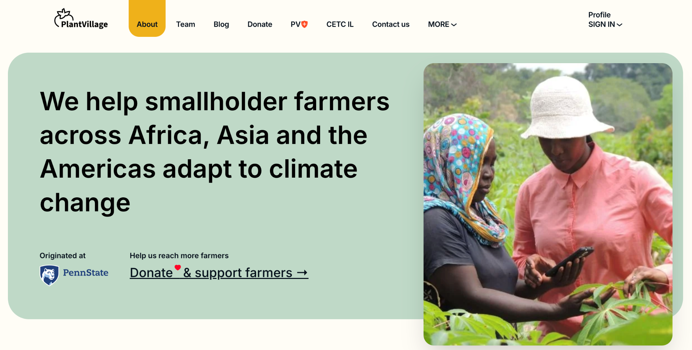
07
Plant Village
Pros:
Research-Backed – Developed with strong scientific backing.
Free Access – Available for research purposes.
Good for Learning – Helps researchers study plant health trends.
Cons:
Limited Disease Detection .
Not Commercially Available – Primarily for research, not for mass adoption.
Requires Expertise – Maintenance needs expert knowledge.
Scalability Issues – Not designed for large expansions.
LEARN MORE
www.agrilens.com

Slide 8
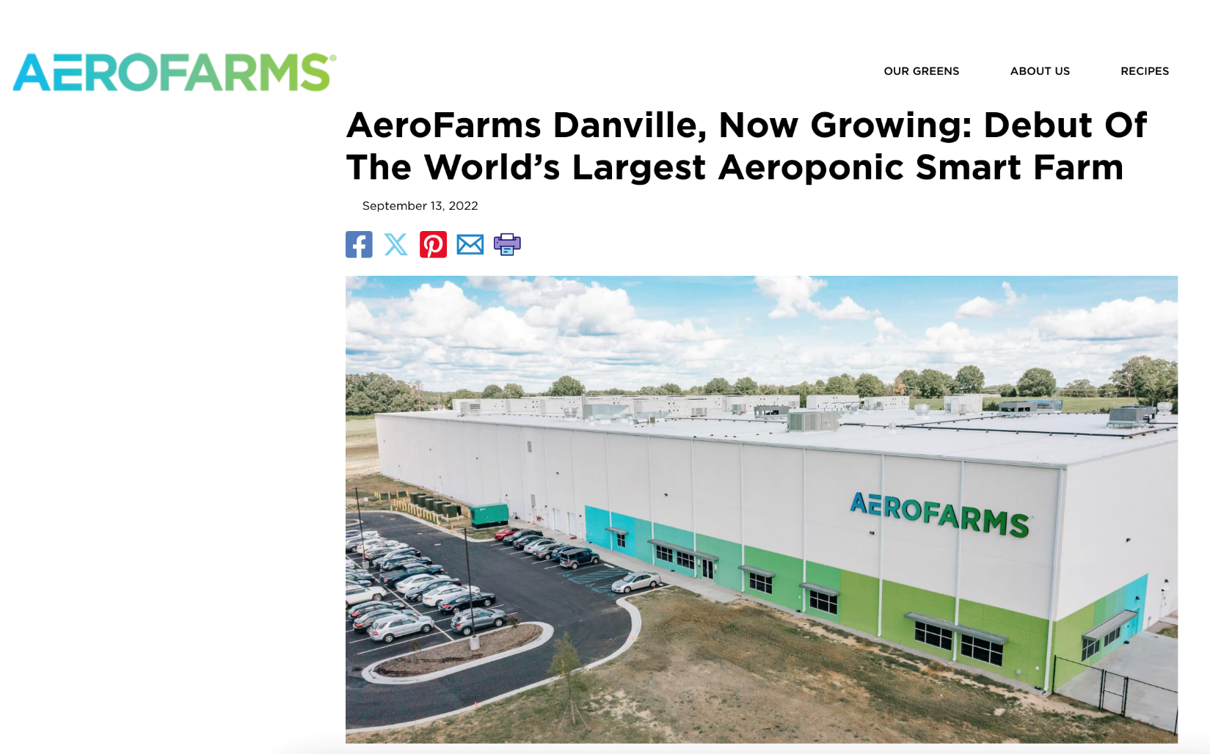
08
Aero Farms Smart Farm
LEARN MORE
www.agrilens.com

Slide 9
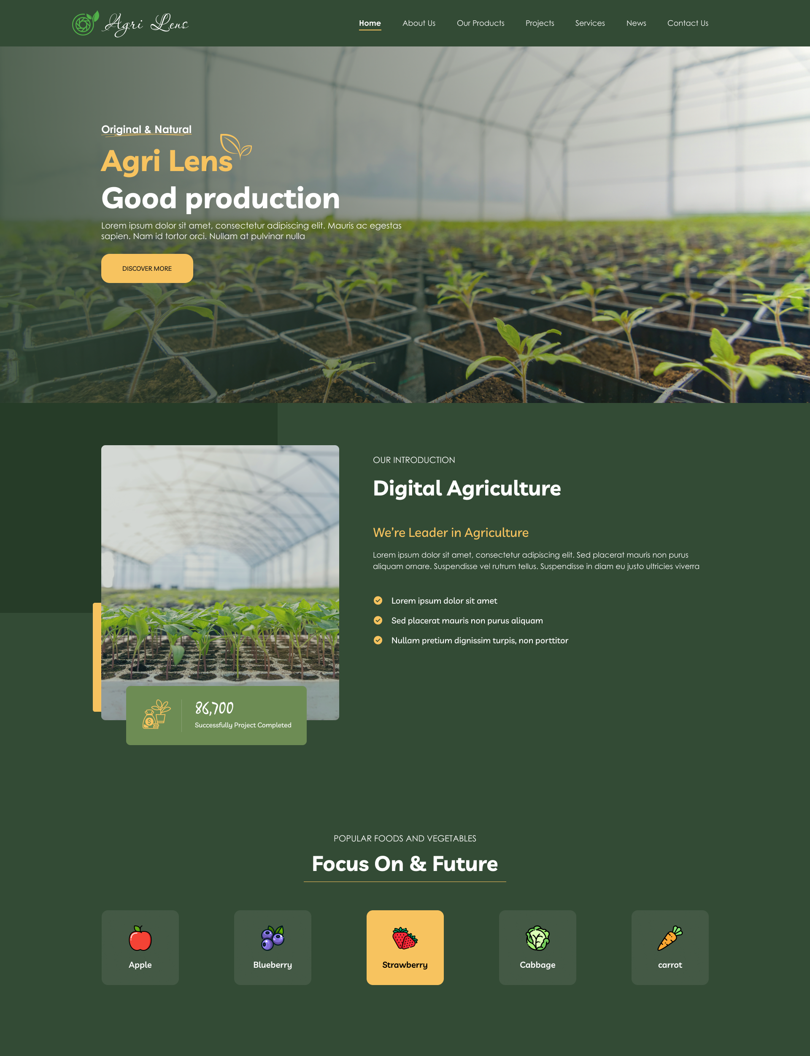
09
Our System | Agri Lens
LEARN MORE
www.agrilens.com

Slide 10
10
AgriLens vs. Competitors
Feature | Plant Village | Aero Farms Smart Farm | AgriLens (Our Solution)
Cost | Free (research-only) | High (millions in investment) | ✅ Cost-effective (small/medium farms)
Real-Time Monitoring | ❌ Limited | ✅ Yes | ✅ Hourly updates
Disease Detection | ❌ Limited | ❌ Limited (external tests needed) | ✅ Advanced detection
Scalability | ❌ Research-scale only | ✅ Enterprise-level | ✅ Modular expansion
Ease of Maintenance | ❌ Requires experts | ❌ Professional team needed | ✅ User-centric design
Accessibility | ✅ Free for research | ❌ Large farms only | ✅ Small/medium farms
Commercial Viability | ❌ Not commercialized | ✅ Yes (for corporations) | ✅ Profitable for farmers
LEARN MORE
www.agrilens.com

Slide 11

11
Business Model
SWOT Analysis

Slide 12
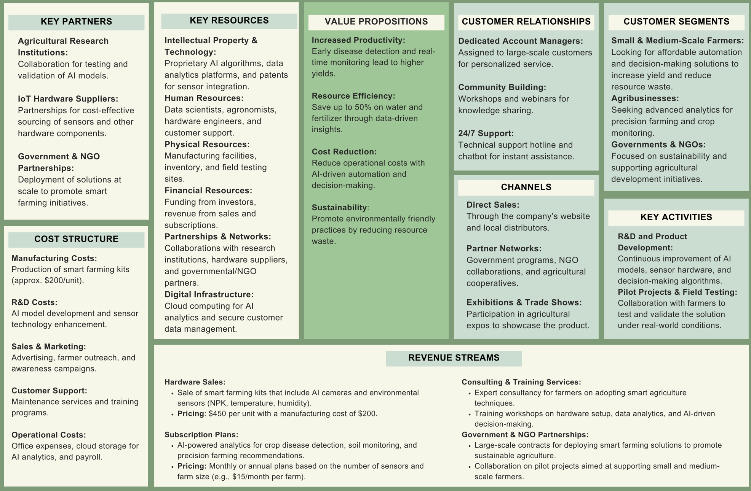
Business Model
12

Slide 13
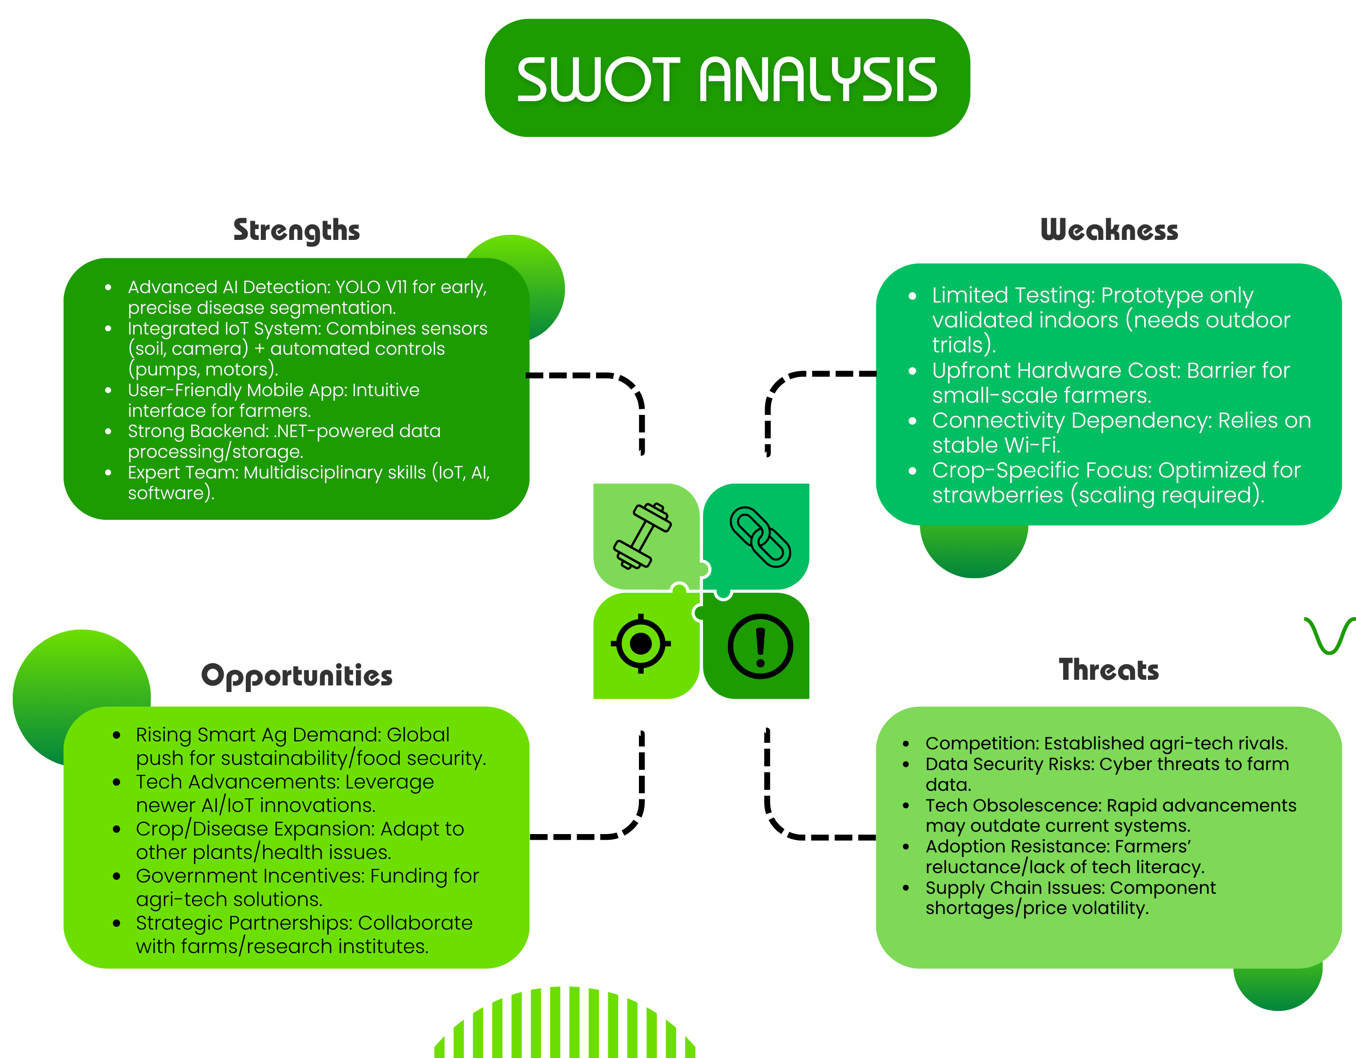
13
Business Model

Slide 14
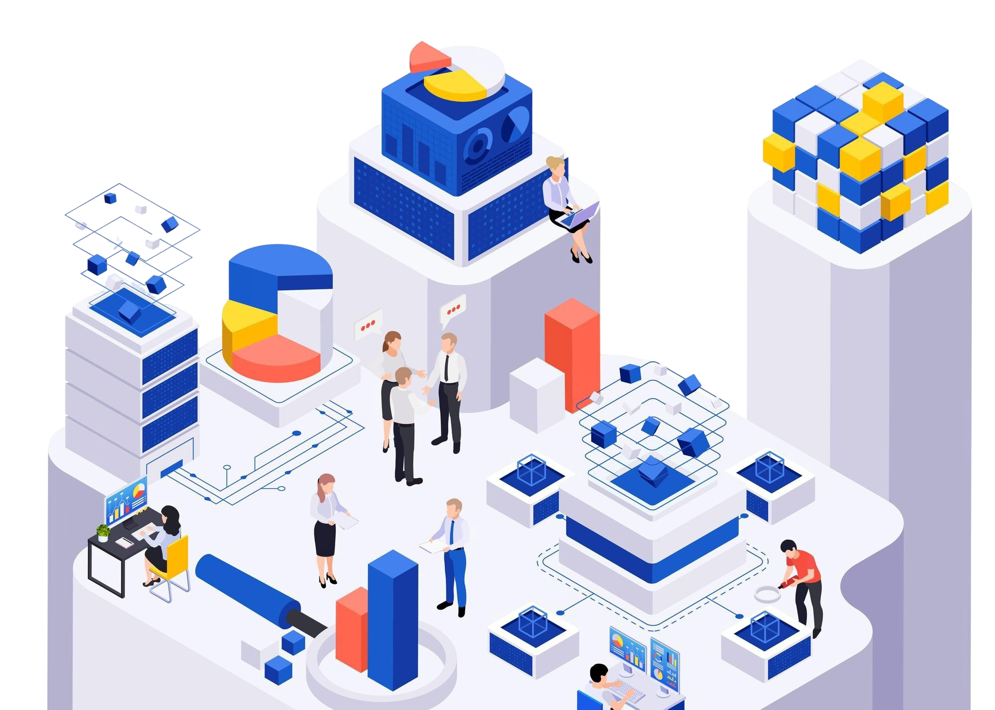
14
SYSTEM ARCHITECTURE SYSTEM Analysis

Slide 15
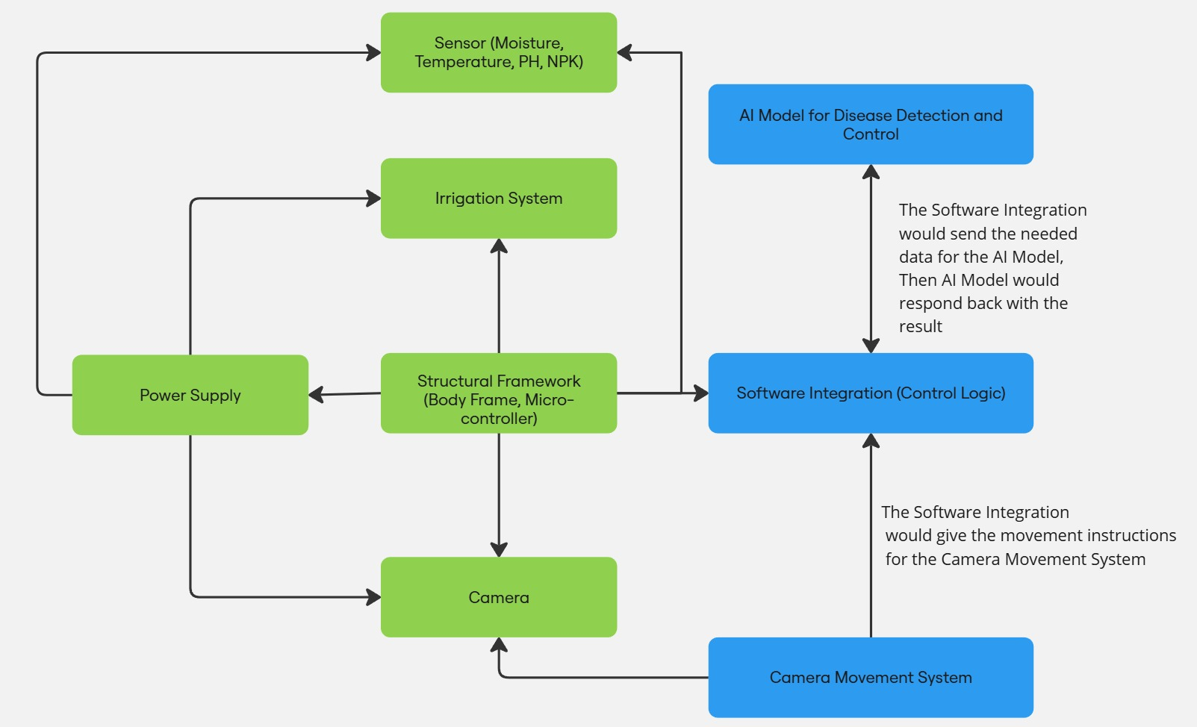
SYSTEM ARCHITECTURE
15

Slide 16
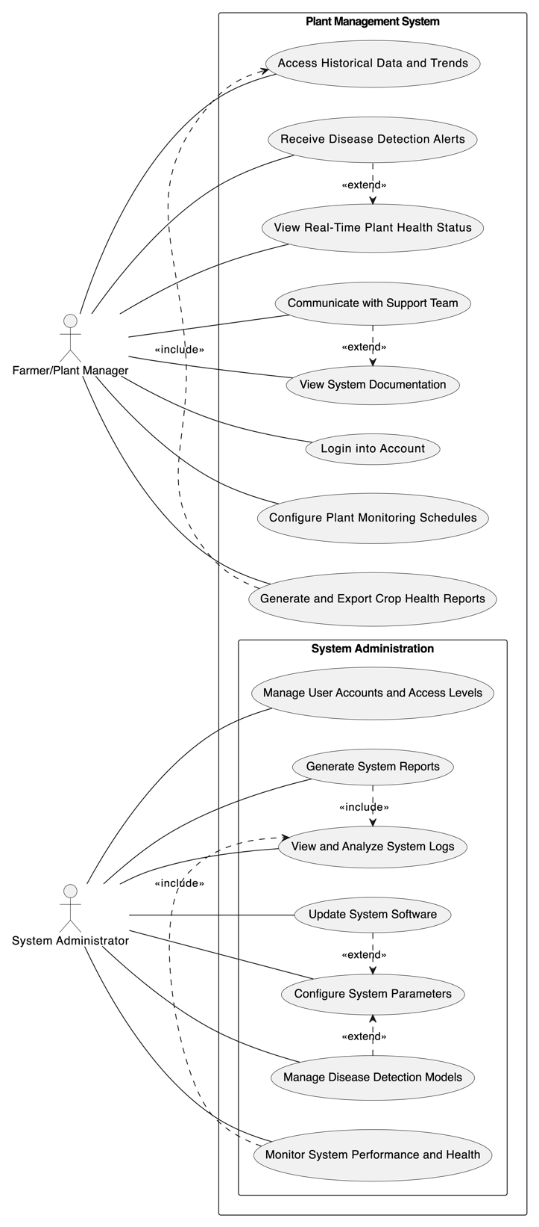
16
SYSTEM Analysis
Farmer/Plant Manager
System Administrator

Slide 17
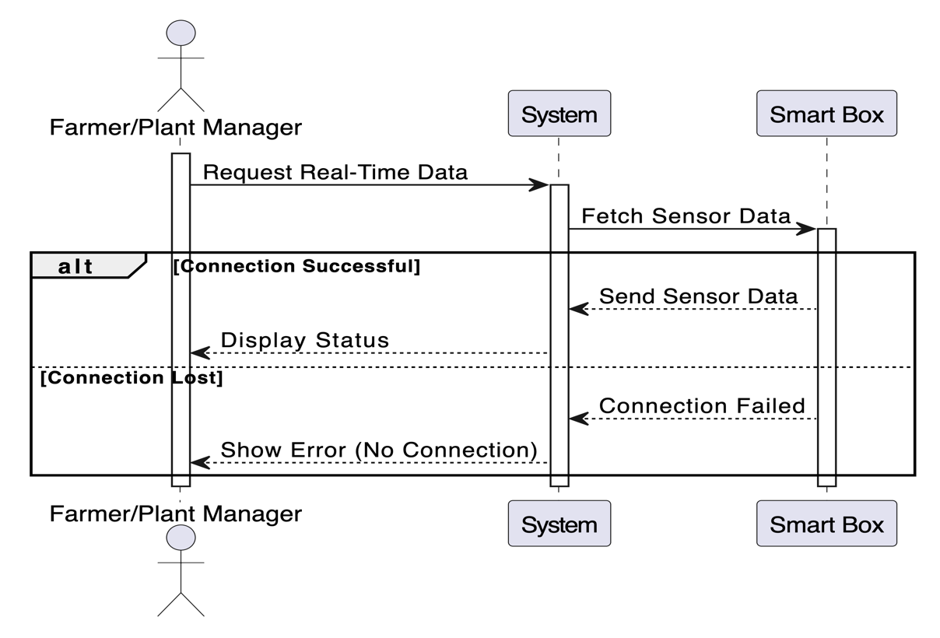
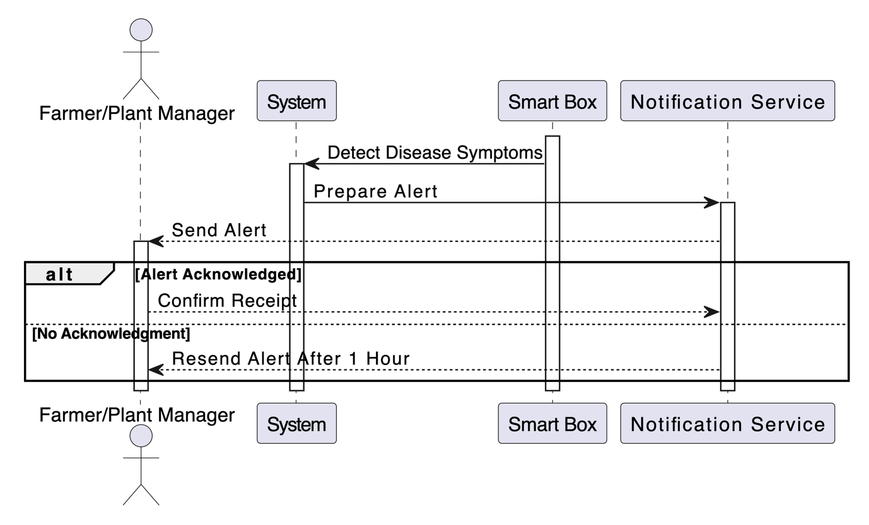
17
SYSTEM Analysis
Plant Manager
View Real-Time Plant Health Status
Receive Disease Detection Alerts

Slide 18
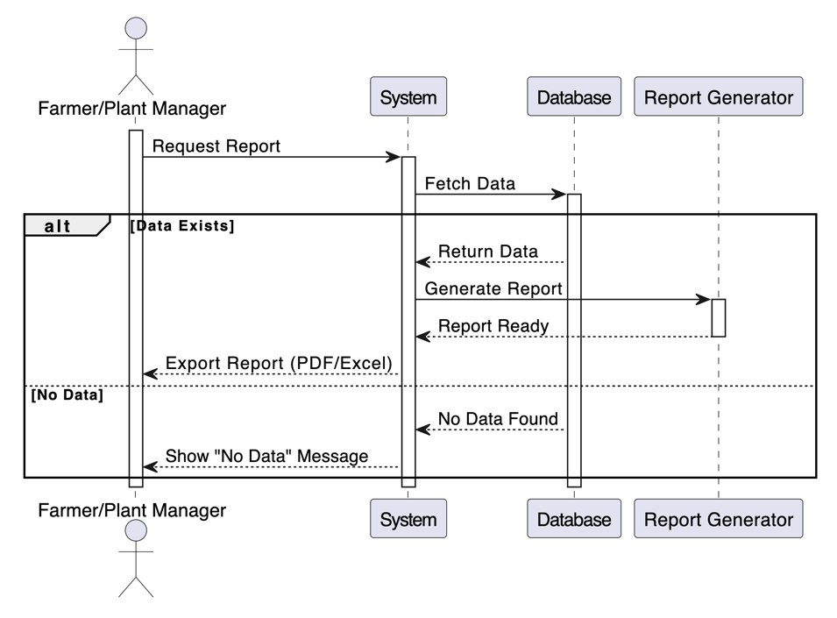
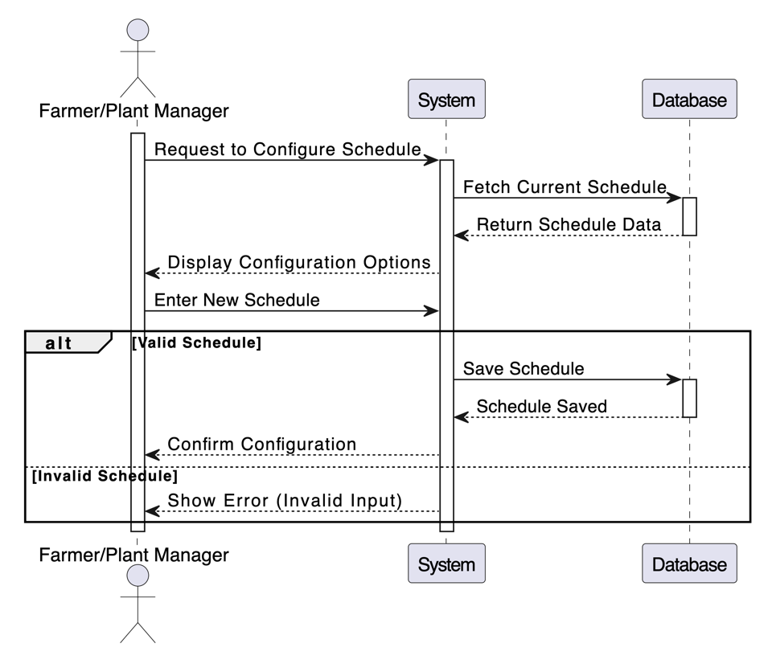
18
SYSTEM Analysis
Plant Manager
Generate and Export Crop Health Reports
Configure Plant Monitoring Schedules

Slide 19
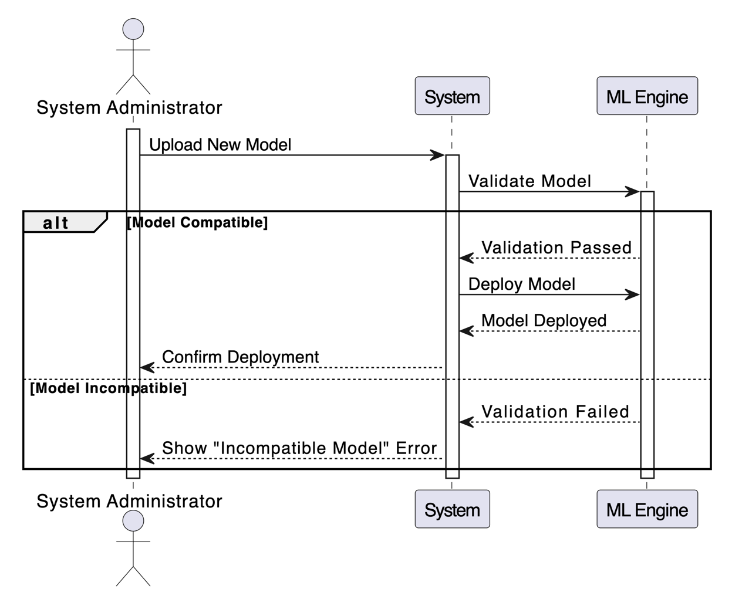
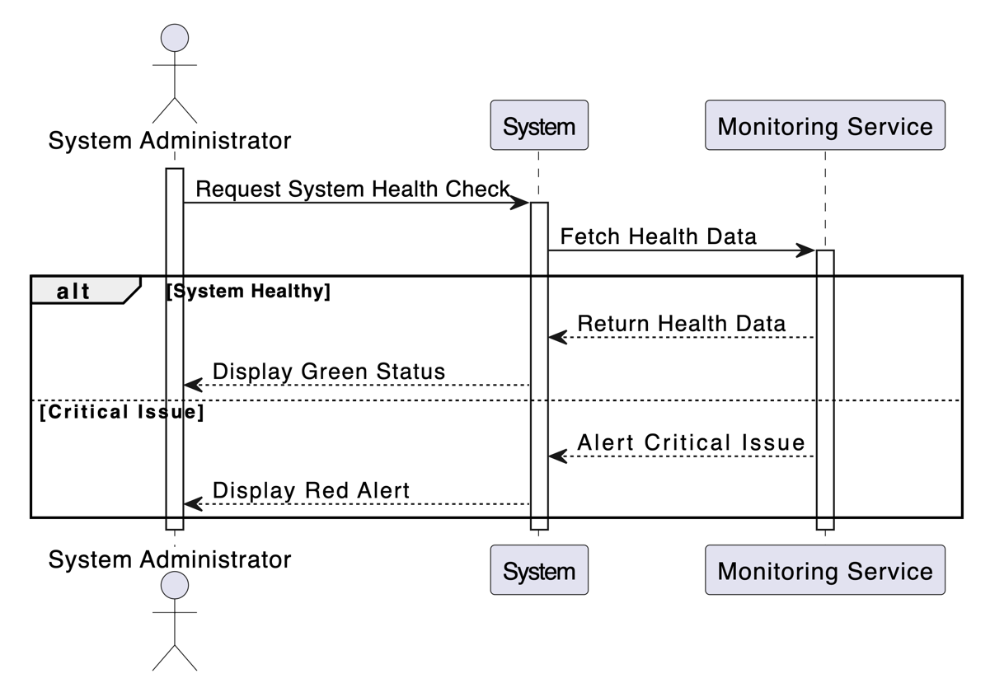
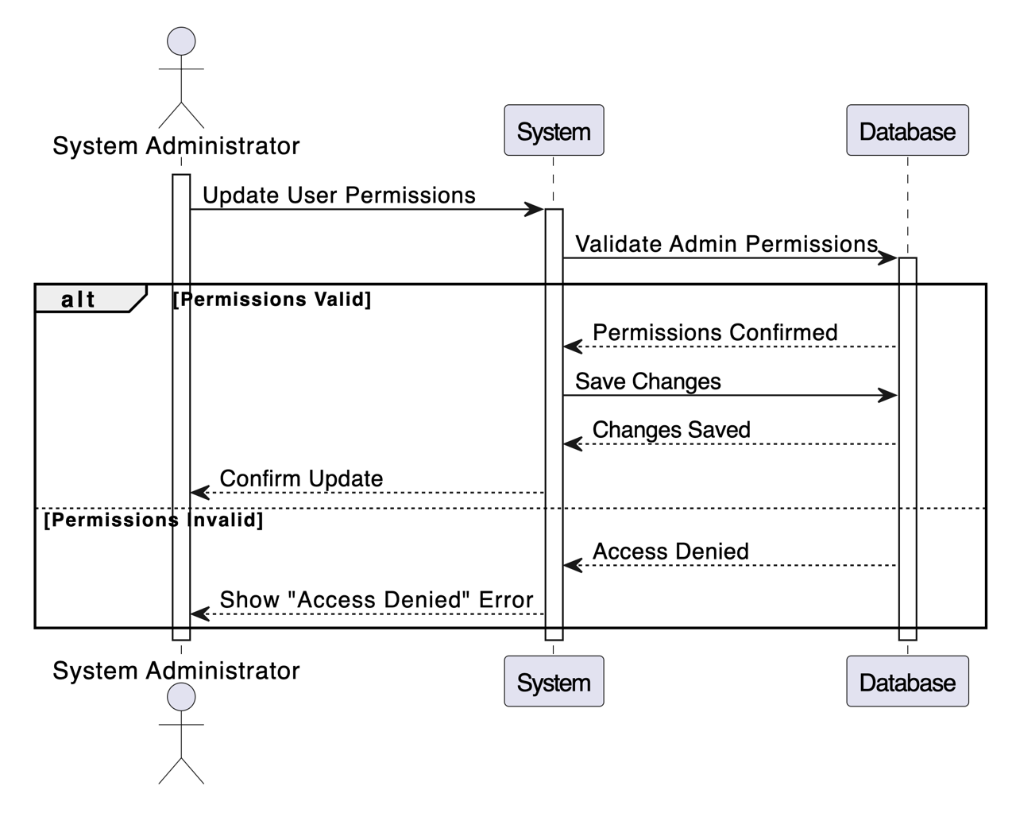
19
SYSTEM Analysis
System Administrator
Manage Disease Detection Models
Monitor System Performance and Health
Manage User Accounts and Access Levels

Slide 20
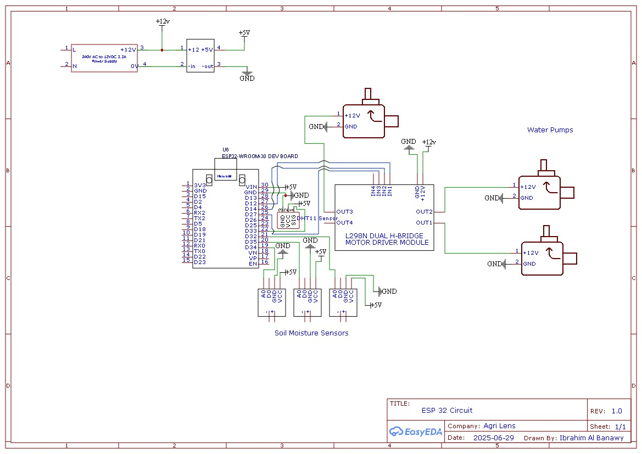
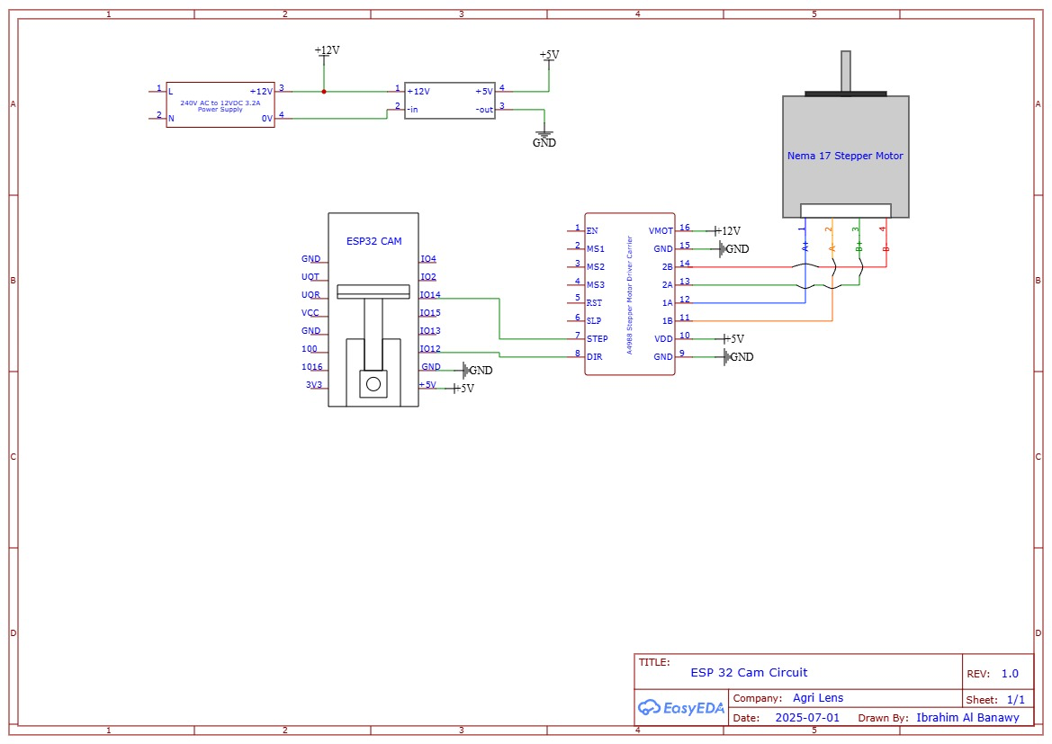
20
Hardware diagram

Slide 21
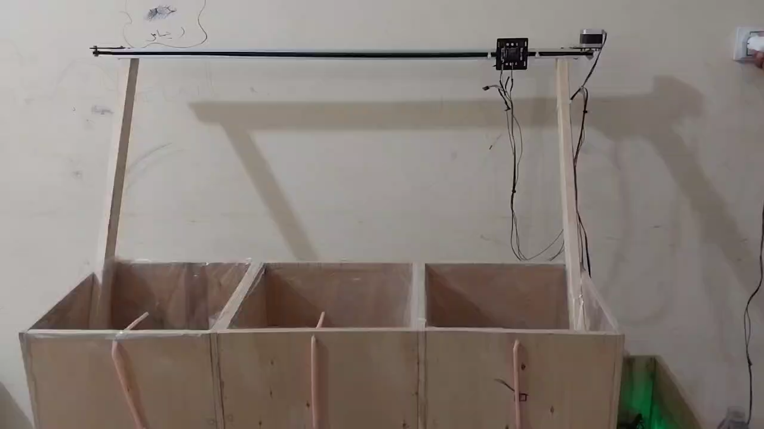
Demo Hardware
21

Slide 22
22
Proposed solution
AI framework

Slide 23
23
Proposed solution
Real-time Monitoring & Control
IoT Layer
Automated Actuation
Data-Driven Intelligence
Centralized Backend
AI-Powered Insights
Farmer Empowerment
Intuitive Mobile App
Goal: To transform traditional farming into a more efficient, sustainable, and productive endeavor through smart automation and actionable insights.
LEARN MORE
www.agrilens.com

Slide 24
24
Phase 1: Understanding Requirements
Phase 2: Data Collection & Dataset Preparation
Phase 3: Model Selection & Model Training
Phase 5: Deployment & Real-World Testing
Phase 4: Model Evaluation
AI framework
Why YOLO V11?
High Accuracy: Capable of precise identification of diseased regions on strawberry leaves.
Instance Segmentation: Provides pixel-level masks, not just bounding boxes, allowing for detailed analysis and targeted intervention.
Early Detection: Designed to identify disease symptoms even in their nascent stages, enabling proactive measures.
Performance Highlights:
Achieved Mask mAP50 of 76.8% and Box mAP50 of 76.6% on our custom dataset, demonstrating robust detection capabilities.
LEARN MORE
www.agrilens.com

Slide 25
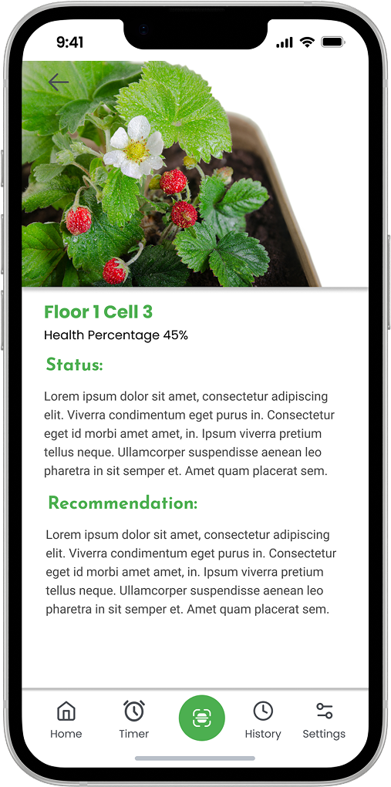
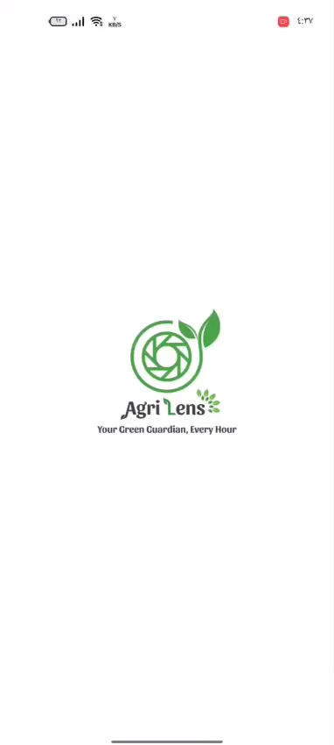
Demo Mobile App
25

Slide 26
26
TECHNOLOGY & TOOLS
LEARN MORE
www.agrilens.com

Slide 27
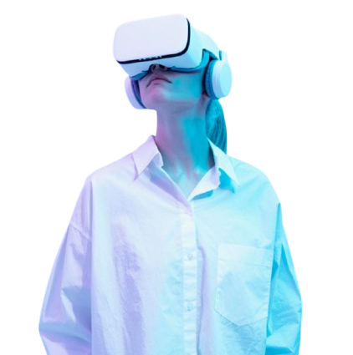
27
FUTURE WORK
Enhanced AI & Machine Learning Integration.
Advanced IoT & Sensor Integration.
Add plants and their diseases
Mobile & Web App Enhancements.
Improve UI/UX for better farmer accessibility.
Integration with Government & Agricultural Agencies
Expansion of Data Analytics & Visualization.
Implement solar-powered IoT sensors and devices.
Introduce AI chatbots for farming-related queries.
Add Maintenance Person as a actor for the system.
LEARN MORE
www.agrilens.com

Slide 28

28
Time Plan
Phase 1: Planning & Requirements (2 weeks)
Phase 2: System Design (2 weeks)
Phase 3: Prototyping | UI UX (3 weeks)
Phase 4: Simulation Design | Hardware (10 weeks)
Phase 5: System Integration (6 weeks)
Phase 6: Comprehensive Testing (2 week)
Phase 7: Deployment & Evaluation (2 week)
Phase 8: Documentation & Handover (2 weeks)
We’re using a hybrid Agile-Waterfall approach, combining structured phases with iterative development. Sequential planning and design phases are followed by overlapping workstreams (e.g., prototyping + UI/UX, hardware + software updates), enabling parallel progress. Incremental integration, testing, and iterative documentation ensure flexibility while maintaining clear milestones for hardware-critical tasks.
LEARN MORE
www.agrilens.com

Slide 29

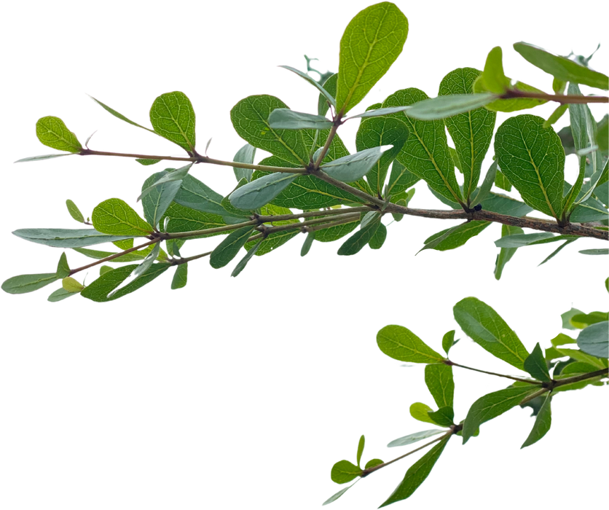
29
Conclusion
This project demonstrates the potential of integrating modern technologies such as IoT, AI, and smart monitoring systems into agriculture to support small , large businesses and hobbyists. By developing an affordable, modular, and user-friendly solution, we aim to empower farmers with real-time insights into their crop health, soil conditions, and irrigation needs, enabling them to make data-driven decisions that optimize productivity and sustainability.
LEARN MORE
www.agrilens.com

Slide 30
30
REFERENCES
Academic Papers & Research:
An Instance Segmentation Model for Strawberry Diseases Based on Mask R-CNN
Existing Platforms & Projects:
PlantVillage
AeroFarms
AI Assistance and Technical Support:
ChatGPT
Acknowledgments
Professors and Engineers Who Helped Us
Professor at the College of Agriculture
Agricultural Engineers
Mechatronics Engineers
LEARN MORE
www.agrilens.com

Slide 31
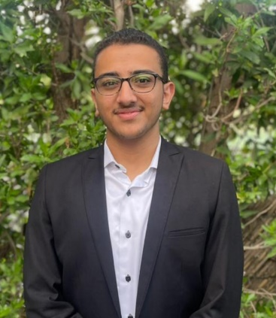
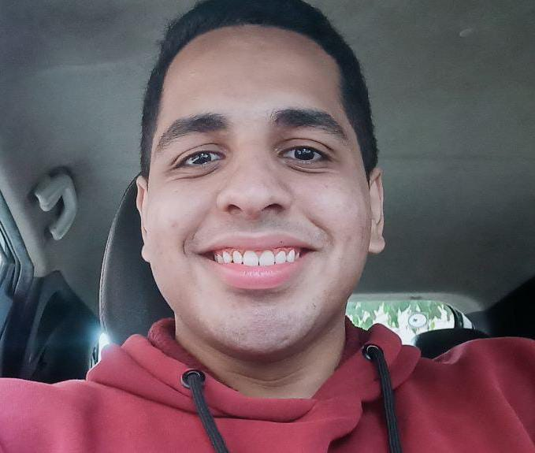
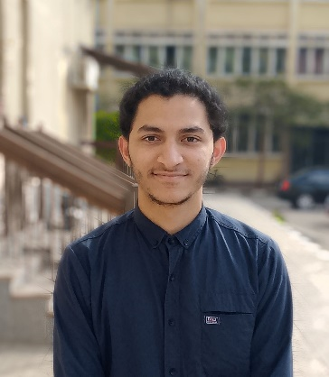
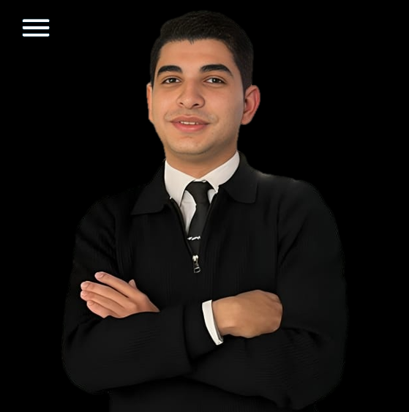
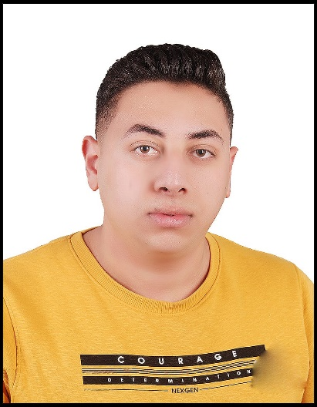
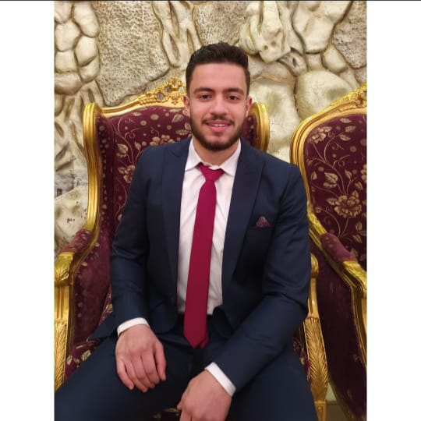
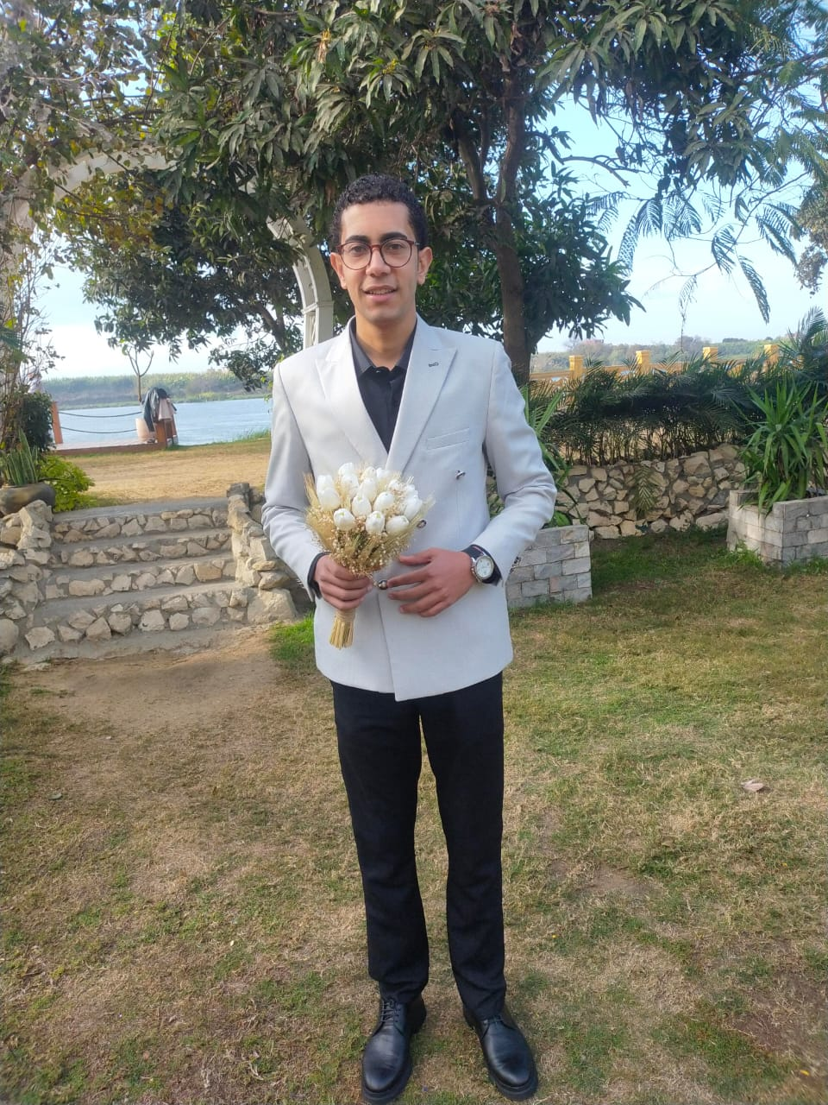

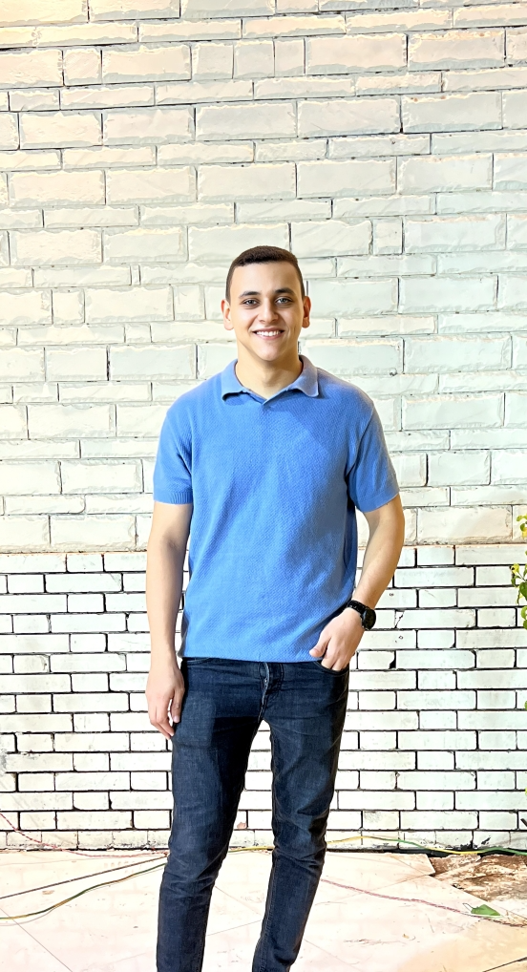
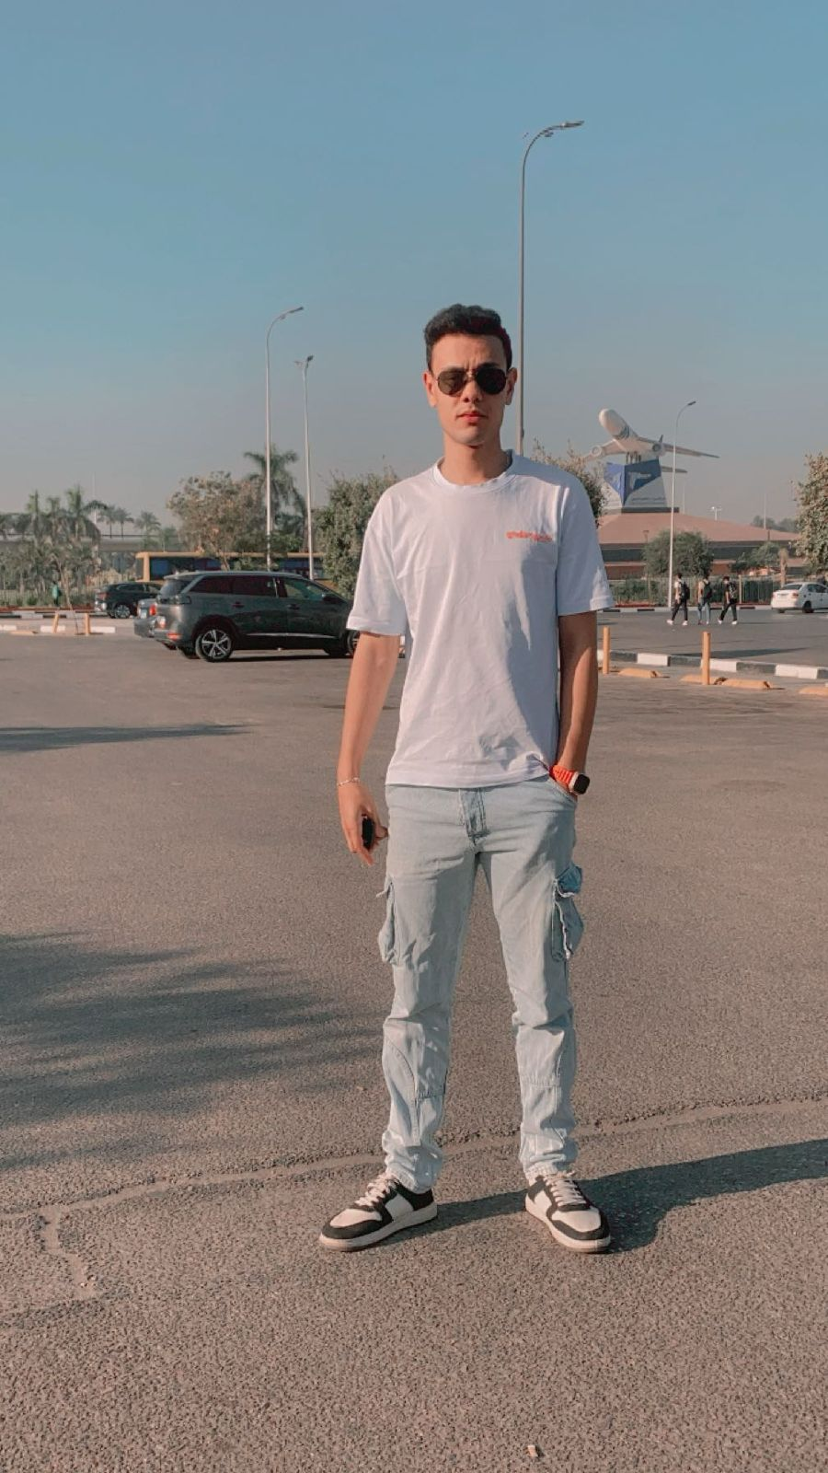
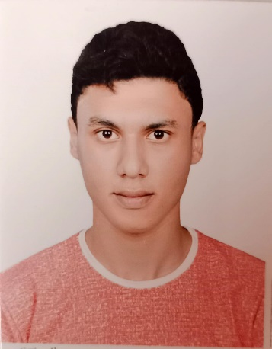
Ibrahim Hegazi
AI developer
Team Leader
Basel Mohamed
Ibrahim Mohamed
Abdelaleem Mohamed
Flutter
Front-End
Product Owner
Ahmed Khalaf
Zeyad Emad
Ahmed Osama
31
AI developer
Front-End
Back-End
TEAM Members
Mohamed Tharwat
Ahmed Ashraf
Ibrahim Saber
UI/UX
Flutter
Back-End

Slide 32
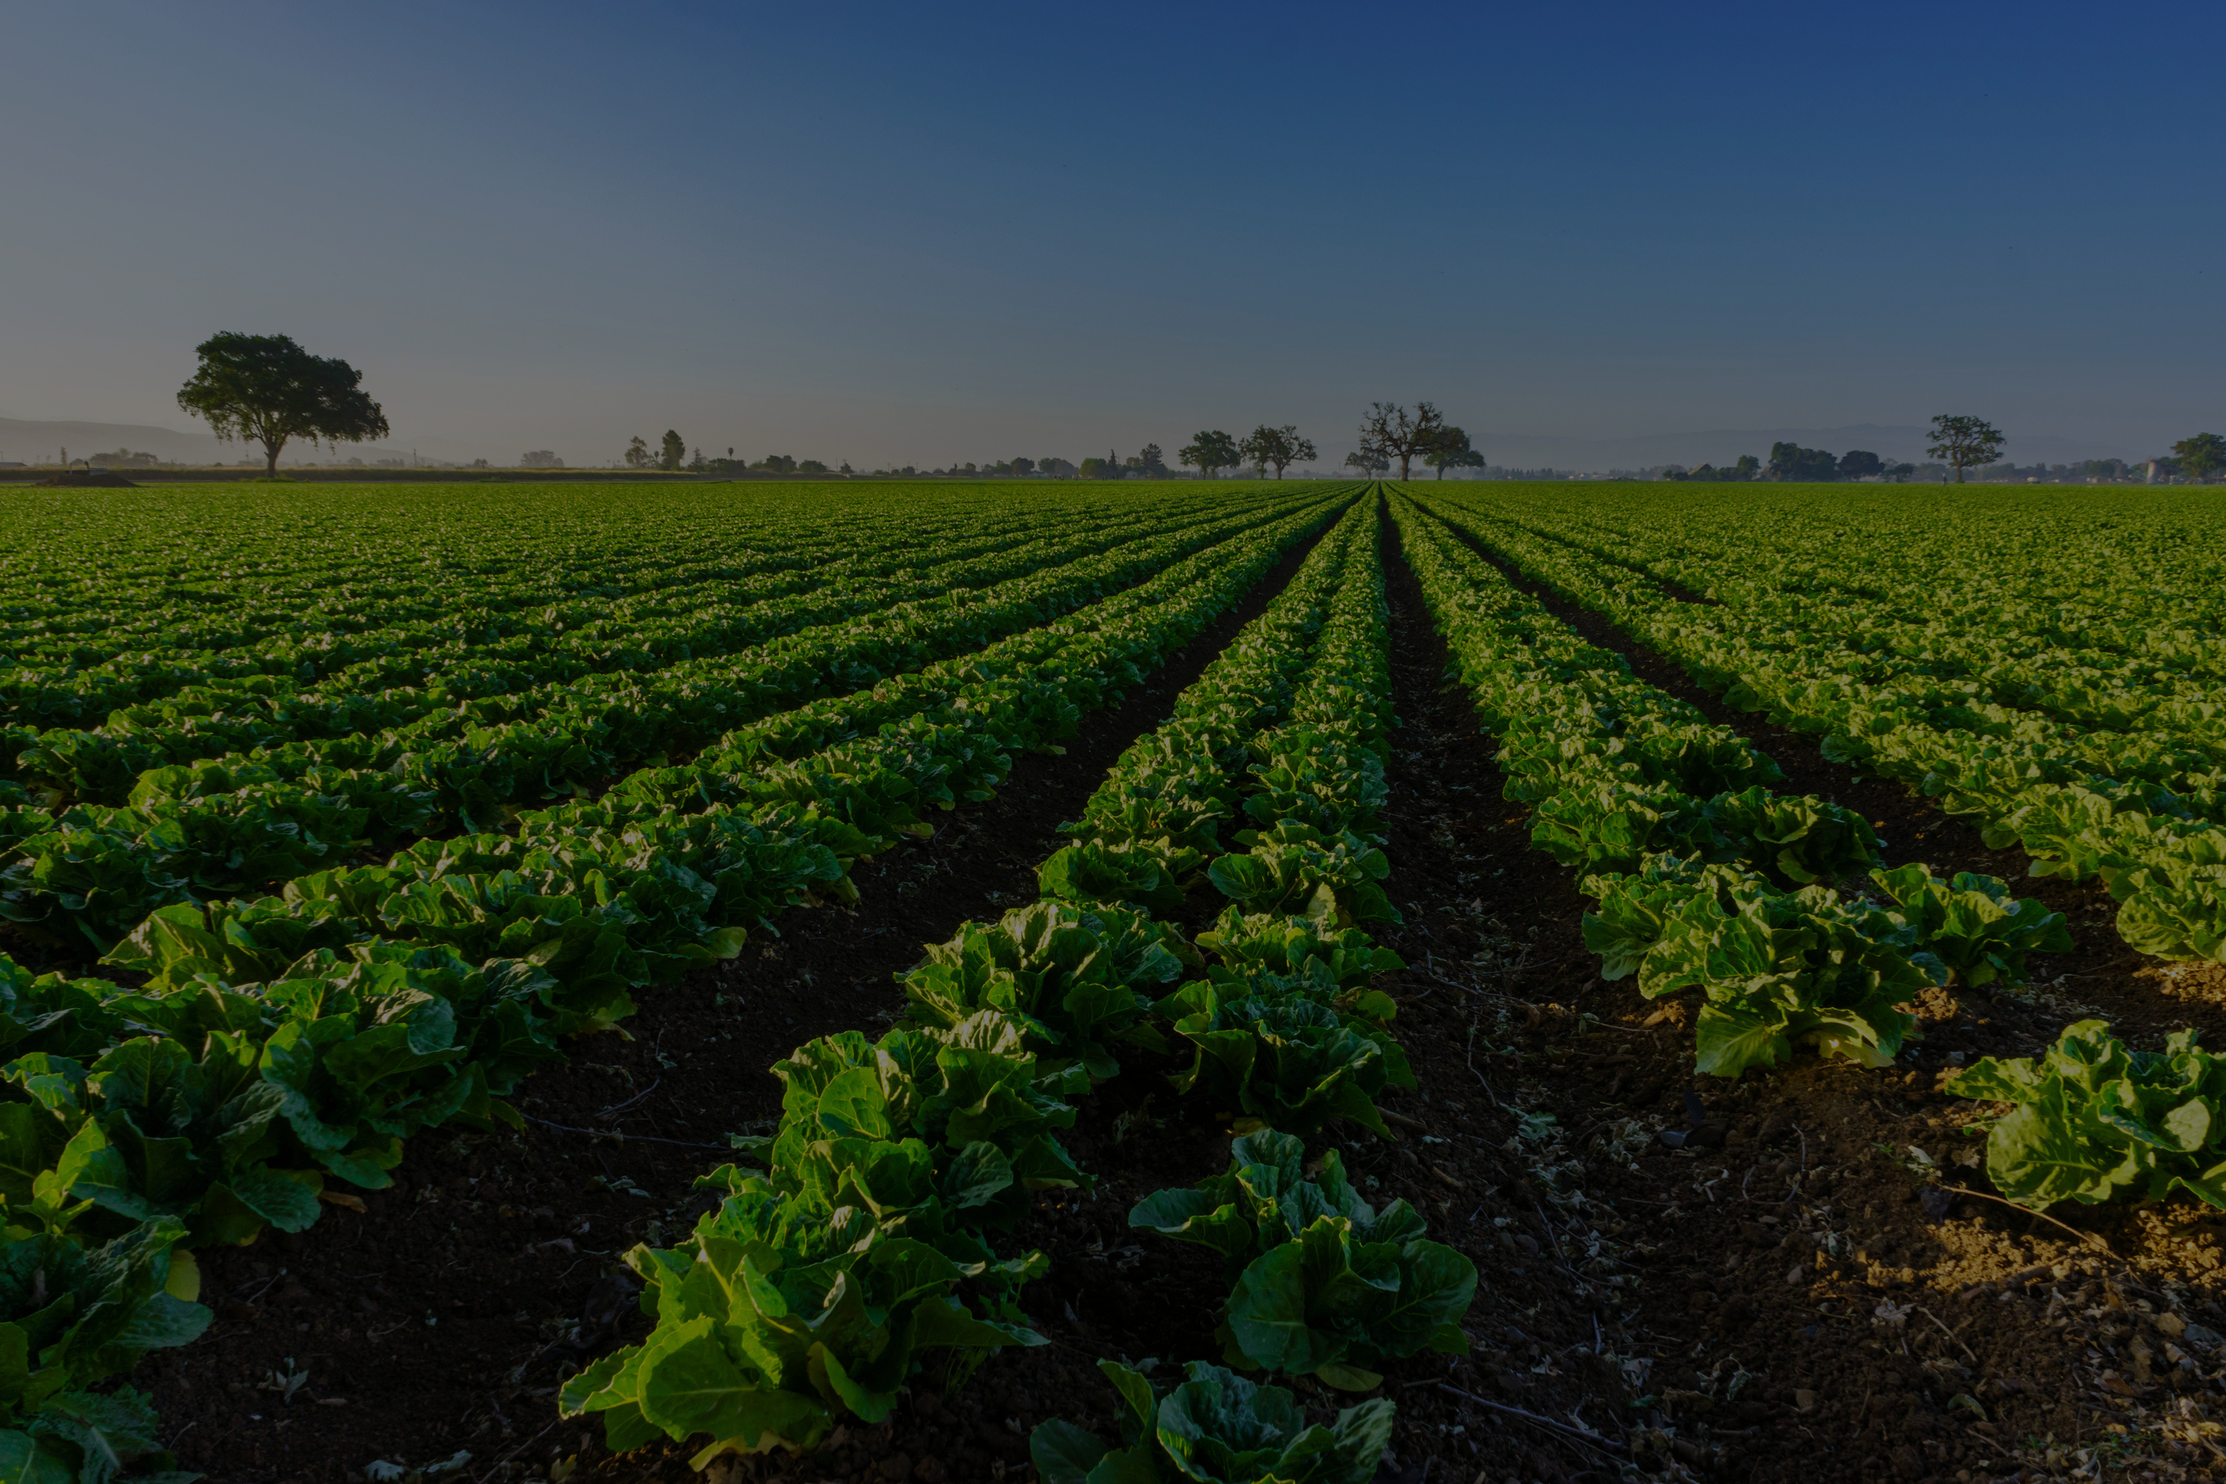


32
Let’s Grow Together!
+201551711251
www.agrilens.com
AgriLens | Instagram

